Slide 1


Introduction to Competitive Programming
Week 2: Sorting + Searching
Notes:
https://join.slack.com/t/introductiont-c5a2137/shared_invite/zt-djtdwpqu-S_tju9SZhk2IKhcYICitCQ

Slide 2
1.
Sorting

Slide 3
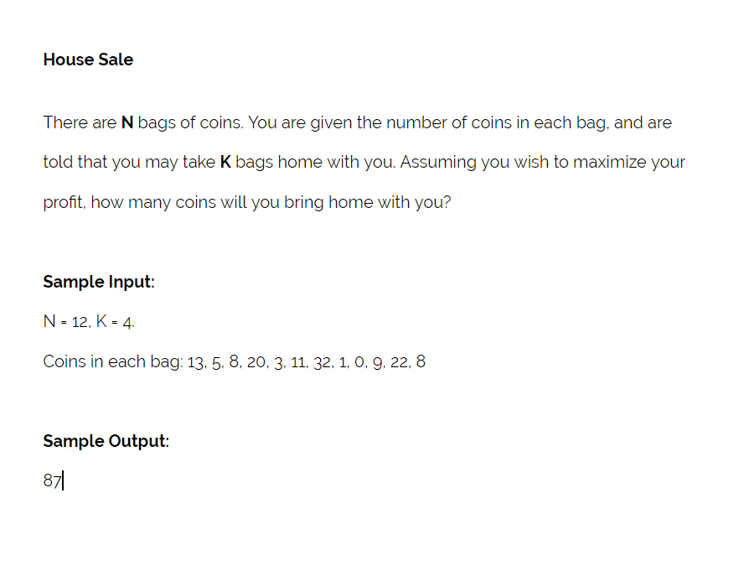
Motivation*

Slide 4
Terminology
Sorting
Put the elements of a list into “sorted” order
Typical “sorted” order: numerically ascending
Others: lexicographical, descending, etc.
Sorting algorithm
Set of steps to be taken in order to sort an arbitrary list

Slide 5
Selection Sort*
Intuition
Selection Sort Animation by Y. Daniel Liang
Formalities
Sorted and unsorted portions
Repeat N times
Go through unsorted portion
Find smallest element
Place into sorted portion

Slide 6
Time Complexity
Recall
Describes the amount of time it takes to run an algorithm
Approximation of the number of operations performed
Examples: O(N²), O(N) etc.
Selection Sort
Repeat N times
Go through unsorted portion
Find smallest element
Place into sorted portion
How many operations do we do here?:

Slide 7
Time Complexity
Recall
Describes the amount of time it takes to run an algorithm
Approximation of the number of operations performed
Examples: O(N²), O(N) etc.
Selection Sort
Repeat N times
Go through unsorted portion
Find smallest element
Place into sorted portion
How many operations do we do here?: N
Time Complexity?:

Slide 8
Time Complexity
Recall
Describes the amount of time it takes to run an algorithm
Approximation of the number of operations performed
Examples: O(N²), O(N) etc.
Selection Sort
Repeat N times
Go through unsorted portion
Find smallest element
Place into sorted portion
How many operations do we do here?: N
Time Complexity?: O(N²)

Slide 9
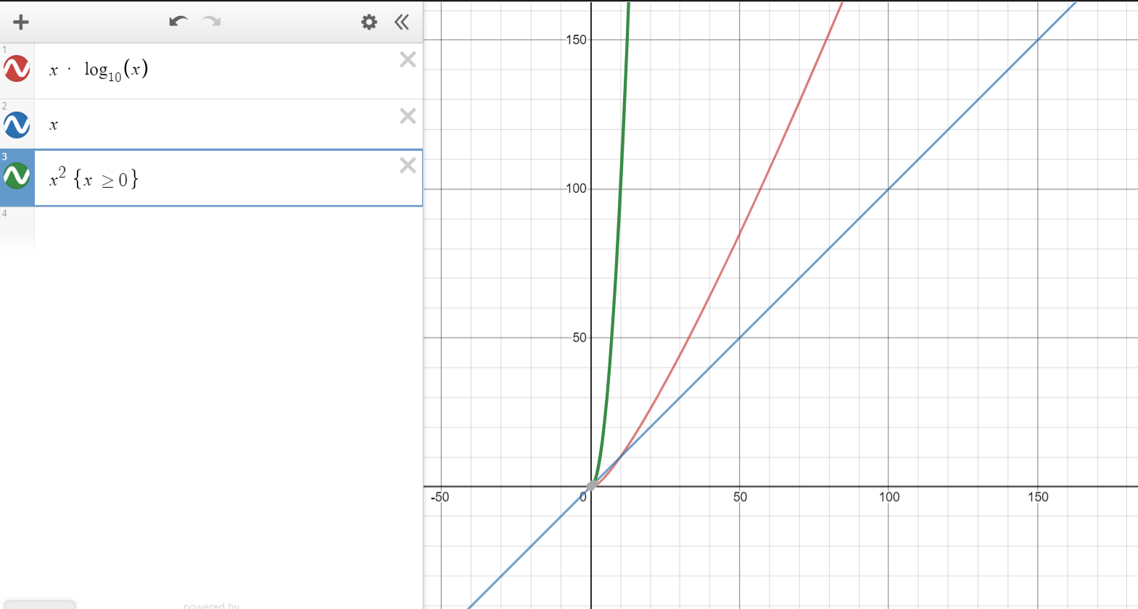
We can do better...
Best time complexity
O(N * log(N))
Merge sort, Quicksort

Slide 10
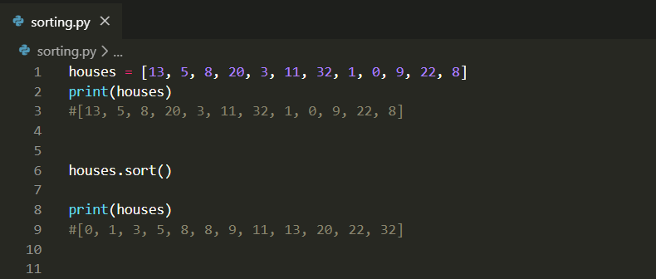
In Practice

Slide 11
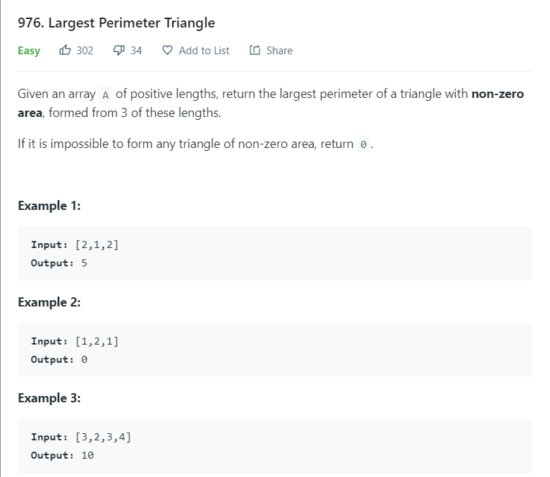
Challenge*

Slide 12
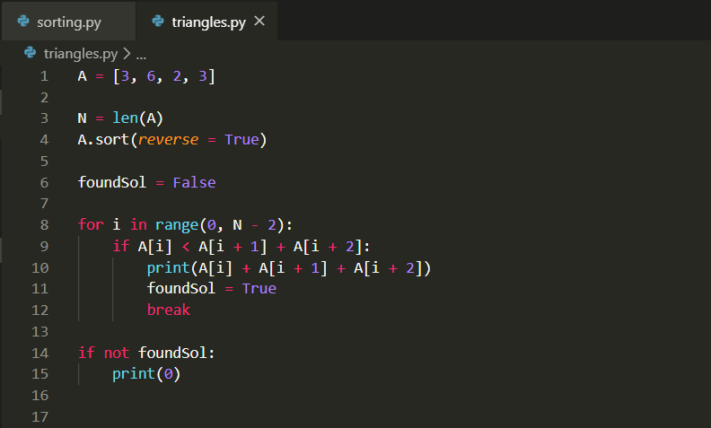
Algorithm

Slide 13
2.
Binary Search

Slide 14
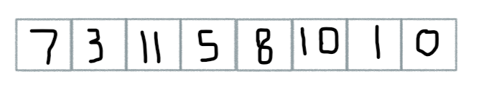
Linear Search
How would you search this array for the value 1?
Imagine searching for a word in a book.
Time Complexity?:

Slide 15
Linear Search
How would you search this array for the value 1?
Imagine searching for a word in a book.
Time Complexity?: O(N)

Slide 16
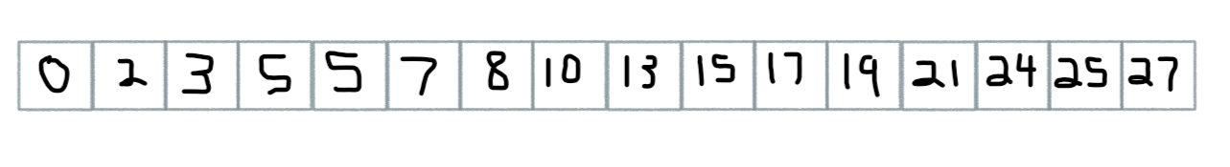
Binary Search*
How would you search this array for the value 21?
Imagine looking through a dictionary for a word.
Time Complexity?:

Slide 17
Binary Search
How would you search this array for the value 21?
Imagine looking through a dictionary for a word.
Time Complexity?: O(log N)

Slide 18
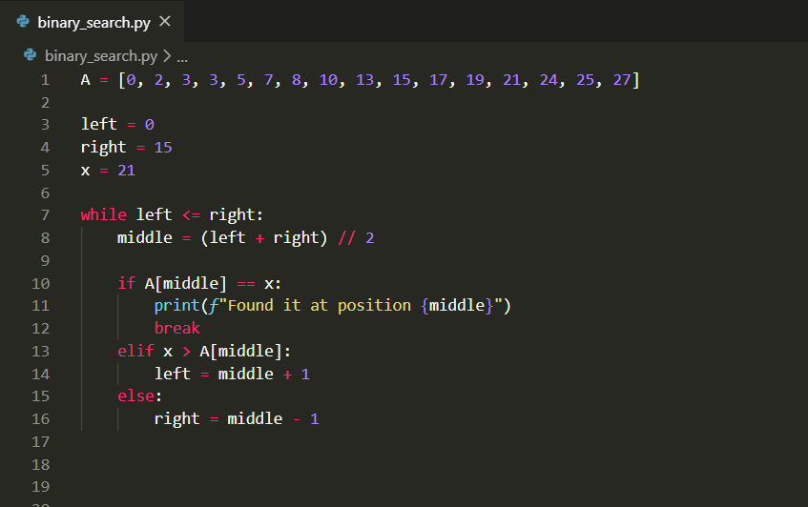
Implementation

Slide 19
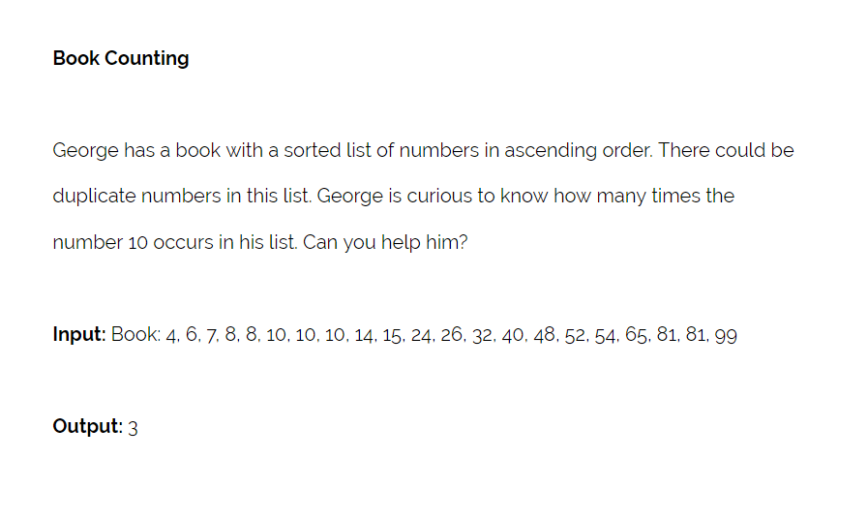
Practice Problem

Slide 20
3.
Finding Optimal Solutions

Slide 21
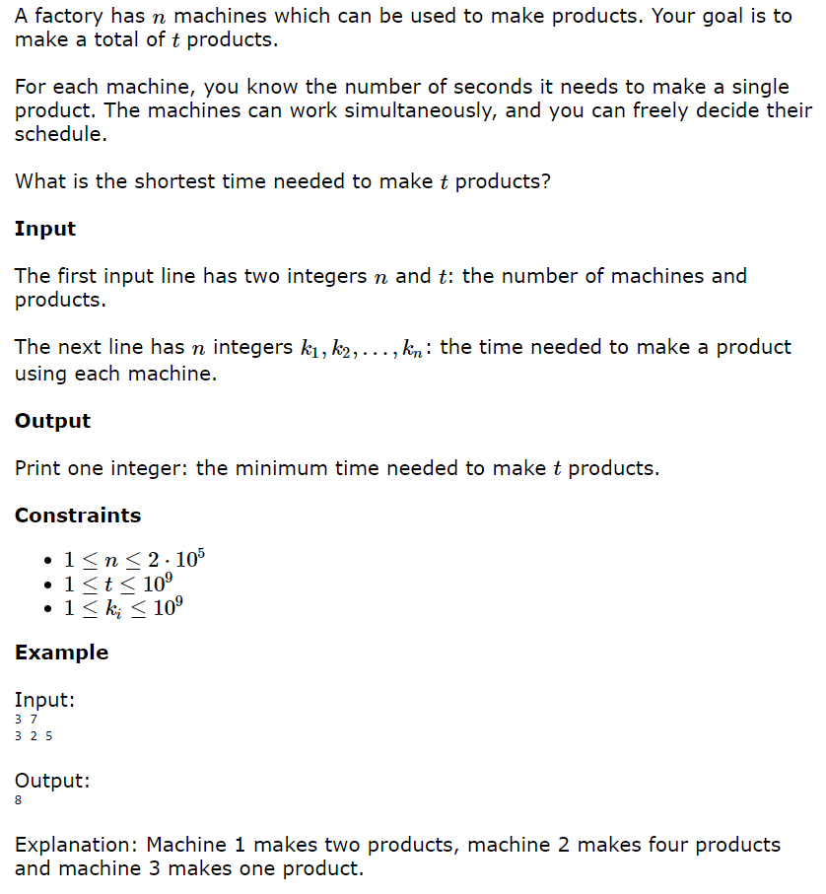
A “Hidden” Binary Search Problem

Slide 22
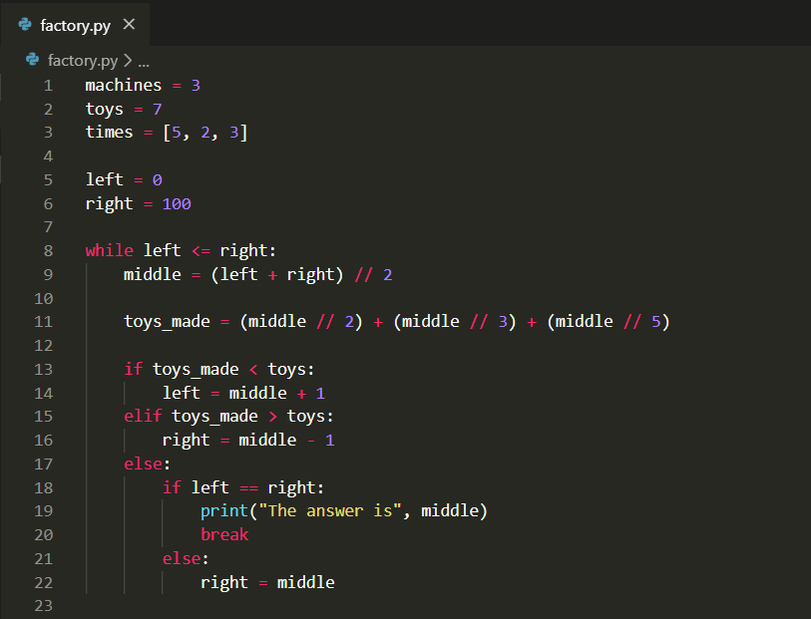
Implementation

Slide 23
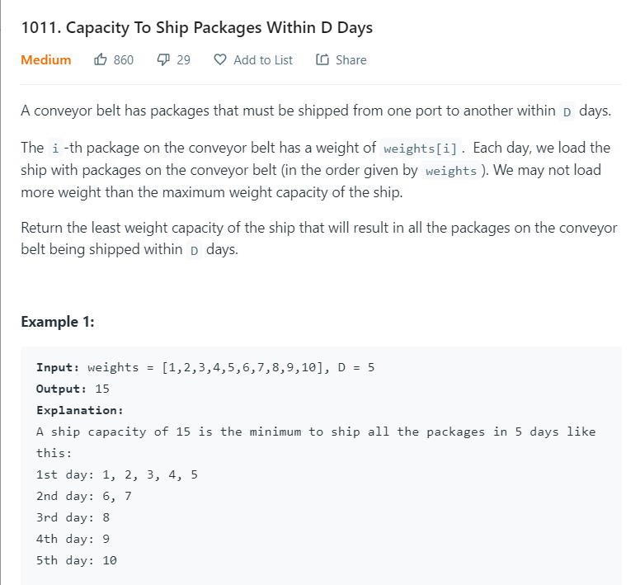
More practice

Slide 24
More practice
Asked at Facebook!
Similar question appeared on the
“Google Code Jam”!
Notice a pattern…?

Slide 25
4.
Endnotes

Slide 26
Homework
Week 2: Binary Search + Sorting
Try sorting the data given (using built-in implementation)
Optimization problem -> use binary search
Highly encouraged
4-5 / week
Discussed on Slack
Leetcode

Slide 27
Thanks!
Any questions?
Contact:
amudide@gmail.com
Slack

